Slide 1
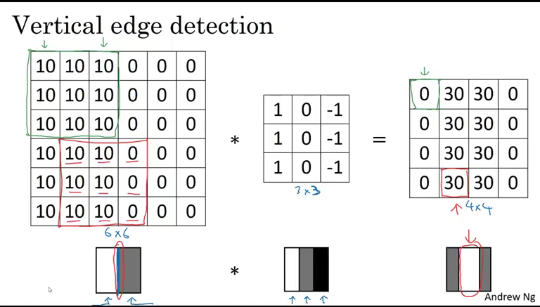
A06 ITAI 1378 Manual CNN
Binary Brains:
Ambalika
Favour
Misty
This Photo by Unknown author is licensed under CC BY-NC.

Slide 2
Step 1
0 | 0 | 0 | 3 | 2 | 0 | 0 | 0
0 | 0 | 0 | -1 | -3 | 0 | 0 | 0
0 | 0 | 0 | 1 | 1 | 0 | 0 | 0
1 | 3 | -3 | -2 | 3 | 2 | 1 | 2
2 | 1 | 1 | -3 | 3 | 1 | 2 | 1
0 | 0 | 0 | 3 | -1 | 0 | 0 | 0
0 | 0 | 0 | 2 | 1 | 0 | 0 | 0
0 | 0 | 0 | -2 | -3 | 0 | 0 | 0

Slide 3
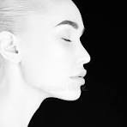
Step 3: Demonstration

Slide 4
Step 2: Design Filters
0 | -1 | 3
2 | 1 | 0
-1 | 2 | 1
0 | 0 | 0
0 | 0 | 0
-1 | 1 | 2
1 | 2 | -1
3 | 0 | -3
-1 | 1 | 0

Slide 5
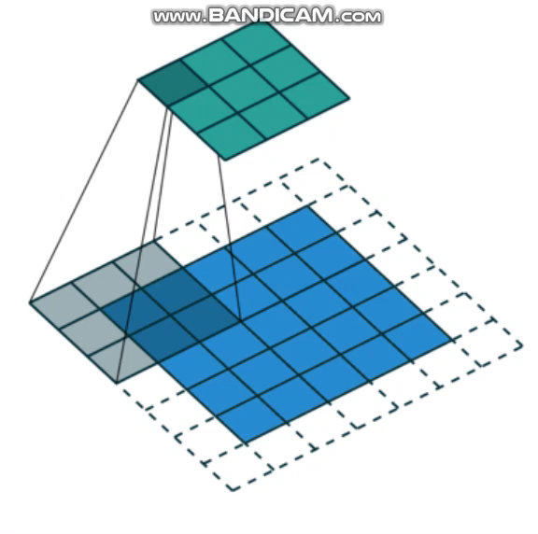

Slide 6
Step 3: Convolve manually
0 | 0 | 0 | 3 | 2 | 0 | 0 | 0
0 | 0 | 0 | -1 | -3 | 0 | 0 | 0
0 | 0 | 0 | 1 | 1 | 0 | 0 | 0
1 | 3 | -3 | -2 | 3 | 2 | 1 | 2
2 | 1 | 1 | -3 | 3 | 1 | 2 | 1
0 | 0 | 0 | 3 | -1 | 0 | 0 | 0
0 | 0 | 0 | 2 | 1 | 0 | 0 | 0
0 | 0 | 0 | -2 | -3 | 0 | 0 | 0
0 | -1 | 3
2 | 1 | 0
-1 | 2 | 1

Slide 7

Step 4 – Identify Features
Receptive Field: Convolution: (Filter) Destination Pixel:
0 | 0 | 0 | 3 | 2 | 0 | 0 | 0
0 | 0 | 0 | -1 | -3 | 0 | 0 | 0
0 | 0 | 0 | 1 | 1 | 0 | 0 | 0
1 | 3 | -3 | -2 | 3 | 2 | 1 | 2
2 | 1 | 1 | -3 | 3 | 1 | 2 | 1
0 | 0 | 0 | 3 | -1 | 0 | 0 | 0
0 | 0 | 0 | 2 | 1 | 0 | 0 | 0
0 | 0 | 0 | -2 | -3 | 0 | 0 | 0
0 | -1 | 3
2 | 1 | 0
-1 | 2 | 1
 | 0
(0*0)+(0*-1)+(0*0)+
(0*2)+(0*1)+(0*0)+
(0*-1)+(0*2)+(0*1) = 0

Slide 8
Step 4 – Continued
Receptive Field: Convolution: (Filter) Destination Pixel:
0 | 0 | 0 | 3 | 2 | 0 | 0 | 0
0 | 0 | 0 | -1 | -3 | 0 | 0 | 0
0 | 0 | 0 | 1 | 1 | 0 | 0 | 0
1 | 3 | -3 | -2 | 3 | 2 | 1 | 2
2 | 1 | 1 | -3 | 3 | 1 | 2 | 1
0 | 0 | 0 | 3 | -1 | 0 | 0 | 0
0 | 0 | 0 | 2 | 1 | 0 | 0 | 0
0 | 0 | 0 | -2 | -3 | 0 | 0 | 0
0 | -1 | 3
2 | 1 | 0
-1 | 2 | 1
 | 8
(1*0)+(1*-1)+(0*3)+
(-2*2)+(3*1)+(2*0)+
(-3*-1)+(3*2)+(1*1)= 8

Slide 9
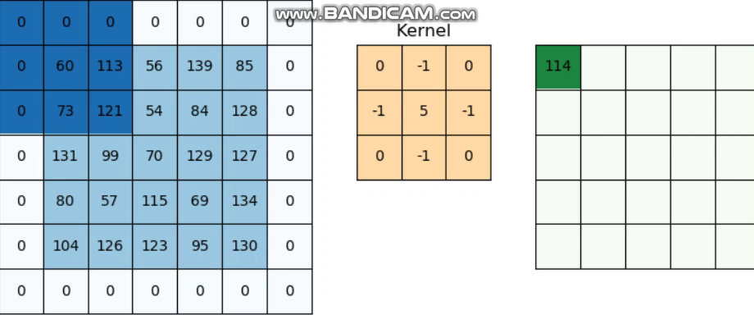

Slide 10
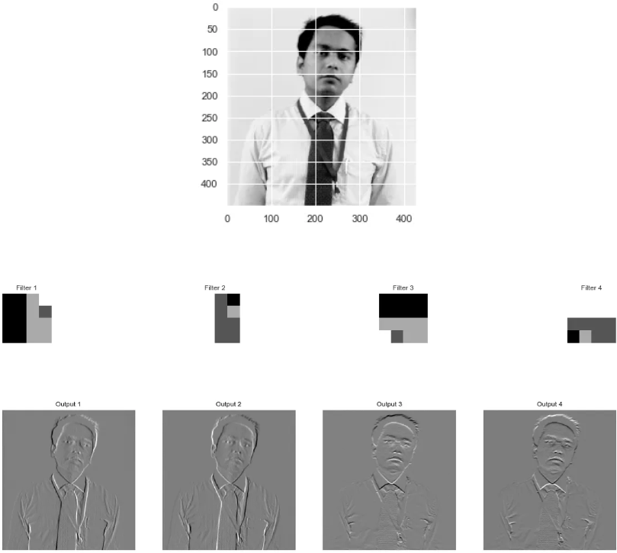

Slide 11
